Slide 1
GAME THEORY
Life is full of conflict and competition. Real life examples involving adversaries in conflict include parlor games, military battles, political campaigns, advertising and marketing campaigns by competing business firms and so forth. A basic feature in many of these situations is that the final outcome depends primarily upon the combination of strategies selected by the adversaries.

Slide 2
Game theory is a mathematical theory that deals with the general features of competitive situations like these in a formal, abstract way. It places particular emphasis on the decision-making processes of the adversaries.
Research on game theory includes many complicated types of competitive situations. However, we shall be dealing only with the simplest case, called Two-Person, Zero Sum Games.

Slide 3
As the name implies, these games involve only two players (or adversaries). They are called Zero-Sum games because one player wins whatever the other one loses, so that the sum of their net winnings is zero.
In general, a Two-Person game is characterized by
The strategies of Player 1.
The strategies of Player 2.
The Pay-off table.

Slide 4
Thus the game is represented by the Pay-off matrix to Player A as:
B₁ B₂ ……… B_{n}
A₁
A₂
.
.
A_{m}
a₁₁ a₁₂ ……… a_{1n}
a₂₁ a₂₂ …........ a_{2n}
.
.
a_{m1} a_{m2} ………. a_{mn}

Slide 5
Here A₁,A₂,…..,A_{m} are the strategies of player A
B₁,B₂,…...,B_{n} are the strategies of player B
a_{ij} is the payoff to player A (by B) when the player A plays strategy A_{i} and B plays B_{j} (a_{ij} is –ve means B receives |a_{ij}| from A)

Slide 6
B
1
2
4 | 5
2 | 3
1
A
2
This is an example of a Stable Game.

Slide 7
B
1
2
2 | -3
-3 | 4
1
A
2
This is an example of an Unstable Game.

Slide 8
A primary objective of Game Theory is the development of rational criteria for selecting a strategy. Two key assumptions are made:
Both players are rational
Both players choose their strategies solely to promote their own welfare (no compassion for the opponent)

Slide 9
Optimal solution of two-person zero-sum games
Problem 1
Determine the saddle-point solution, the associated pure strategies, and the value of the game for the following game. The payoffs are for player A.

Slide 10
B₁ B₂ B₃ B₄
Row min
A₁
A₂
A₃
8 6 2 8
8 9 4 5
7 5 3 5
2
4
3
Col 8 9 4 8
Max-min
Max
Min- max

Slide 11
The solution of the game is based on the principle of securing the best of the worst for each player. If the player A plays strategy 1, then whatever strategy B plays, A will get at least 2.
Similarly, if A plays strategy 2, then whatever B plays, will get at least 4. and if A plays strategy 3, then he will get at least 3 whatever B plays.
Thus to maximize his minimum returns, he should play Strategy 2.

Slide 12
Now if B plays strategy 1, then whatever A plays, he will lose a maximum of 8. Similarly for strategies 2,3,4. (These are the maximum of the respective columns). Thus to minimize this maximum loss, B should play strategy 3.
and 4 = max (row minima)
= min (column maxima)
is called the value of the game = ν
4 is called the saddle-point.

Slide 13
Aliter:
Definition: A strategy is dominated by a second strategy if the second strategy is always at least as good (and sometimes better) regardless of what the opponent does. Such a dominated strategy can be eliminated from further consideration.

Slide 14
Thus in our Example (below), for player A, strategy A₃ is dominated by the
strategy A₂ and so can be eliminated.
B₁ B₂ B₃ B₄
A₁
A₂
A₃
8 6 2 8
8 9 4 5
7 5 3 5
Eliminating the strategy A₃ , we get the

Slide 15
following reduced payoff matrix:
B₁ B₂ B₃ B₄
A₁
A₂
8 6 2 8
8 9 4 5
Now , for player B, strategies B₁, B₂, and B₄
are dominated by the strategy B₃.
Eliminating the strategies B₁ , B₂, and B₄ we get the reduced payoff matrix:

Slide 16
following reduced payoff matrix:
B₃
A₁
A₂
2
4
Now , for player A, strategy A₁ is dominated
by the strategy A₂.
Eliminating the strategy A₁ we thus see that A should always play A₂ and B always B₃ and the value of the game is 4 as before.

Slide 17
Problem 2:(a)
The following game gives A’s payoff. Determine p,q that will make the entry (2,2) a saddle point.
B₁ B₂ B₃
Row min
min(1,q)
min(p,5)
2
A₁
A₂
A₃
1 q 6
p 5 10
6 2 3
Col max max(p,6) max(q,5) 10

Slide 18
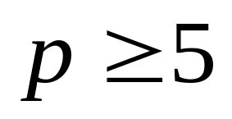
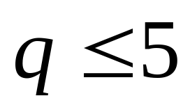
Since (2,2) i.e. 5 must be a saddle point,
and

Slide 19
Problem 3:
Specify the range for the value of the game in the following case assuming that the payoff is for player A.
B₁ B₂ B₃
Row min
1
2
A₁
A₂
A₃
3 6 1
5 2 3
4 2 4
2
4
Col max 5 6

Slide 20
Thus max( row min) <= min (column max)
We say that the game has no saddle point. Thus the value of the game lies between 2 and 3.
Here both players must use random mixes of their respective strategies so that A will maximize his minimum expected return and B will minimize his maximum expected loss.

Slide 21
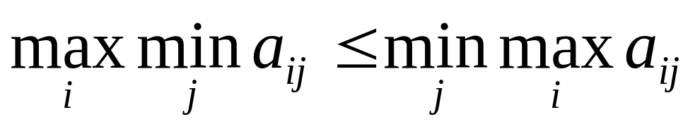
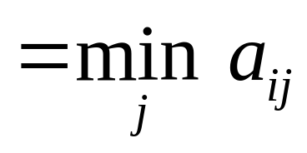
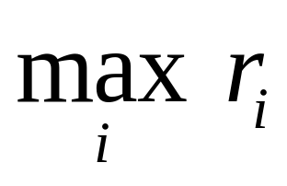
Problem 5 :
Show that in the payoff matrix (payoff for player A) that
Solution let r_{i} = i^{th} row minimum
Let r =

Slide 22
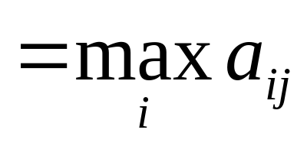
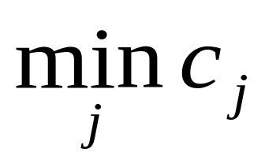
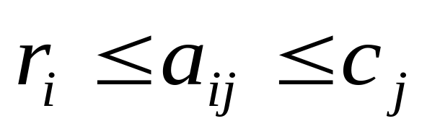
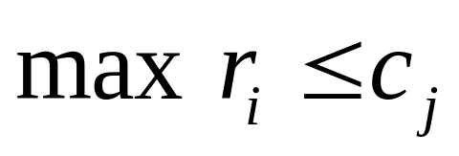
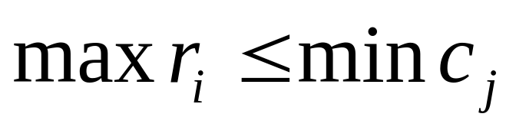
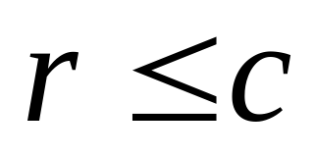
Let c_{j} = j^{th} column max
Let c =
Now, for all i,j
Therefore,
for all j
Therefore,
or

Slide 23
Solution of mixed strategy games
Whenever a game does not possess a saddle point, game theory advises each player to assign a probability distribution over his/her set of strategies. Mathematically speaking,
Let x_{i} = probability that player A will use strategy A_{i} (i = 1,2,…m)
y_{j} = probability that player B will use strategy B_{j} (j = 1,2,…n)

Slide 24
In this context, the mini-max criterion says that a given player should select the mixed strategy that minimizes the maximum expected loss to himself; equivalently that maximizes the minimum expected gain to himself.

Slide 25
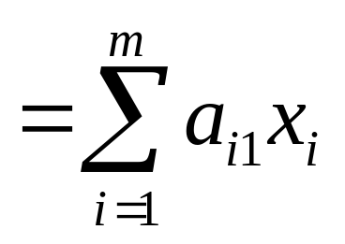
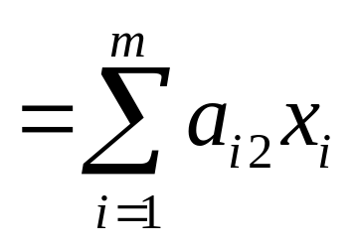
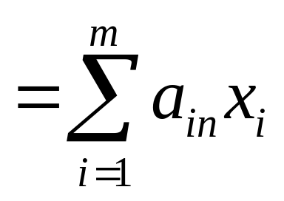
Thus player A’^{s} expected payoff
when B plays strategy B₁
when B plays strategy B₂
. . .
when B plays strategy B_{n}

Slide 26
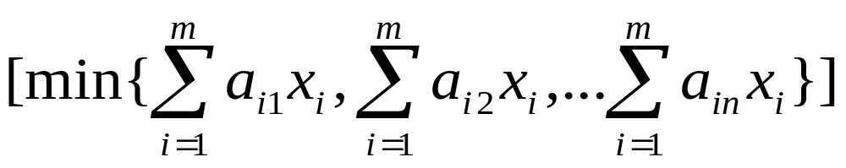
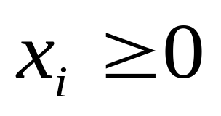
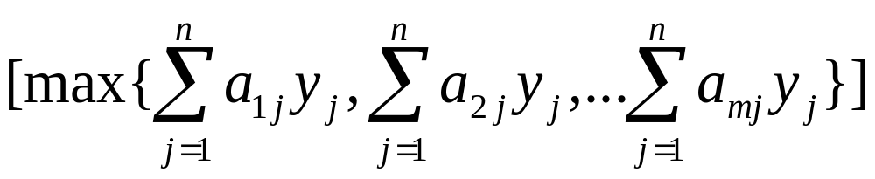
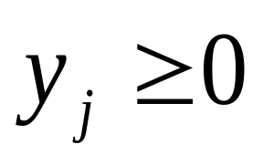
Thus A should
Maximize:
where x₁+x₂+…+x_{m}=1,
Similarly B should
Minimize:
where y₁+y₂+…+y_{n}=1,

Slide 27
Graphical solution of mixed strategy games:
Consider the following problem in which player A has only two strategies. The matrix is payoff matrix for player A:
B₁ B₂ B₃
A₁
A₂
1 -3 7
2 4 -6
Let x₁ be the probability with which player A plays the strategy 1 so that 1-x₁ is the probability with which he will play the strategy 2.

Slide 28
A’^{s} expected payoff when B plays the
Pure strategy B₁ is 1× x₁ + 2 ×(1-x₁) = - x₁ + 2
B₂ is -3 × x₁ + 4 ×(1-x₁) = -7x₁+4
B₃ is 7 × x₁ – 6 ×(1-x₁) = 13x₁- 6
Hence he should maximize
min: { -x₁+2 , -7x₁+4 , 13x₁-6 }
Now we draw the graphs of the straight lines:
v = -x₁+2, v = -7x₁+4, v = 13x₁-6 for 0 ≤ x ≤ 1

Slide 29
B₂
B₁
(1/2,1/2)
x₁
1
B₃

Slide 30
We find that the minimum of 3 expected payoffs correspond to the lower portion of the graph (marked by vertical lines). Thus the maximum occurs at x = ½ and the value of the game is v = ½ (the corresponding ordinate). Now let B play the strategies with probabilities y₁, y₂, y₃.
By the graph above we find B should play the strategy B₁ with probability 0 (otherwise A will get a higher payoff).

Slide 31
Thus B’^{s} expected payoff to A are:
0y₁ - 3y₂ + 7(1-y₂) = -10y₂ + 7
when A plays strategy 1
and 0y₁ + 4y₂ - 6(1-y₂) = 10y₂ - 6
when A plays strategy 2
For optimal strategy -10y₂ + 7 = 10y₂ - 6
or 20 y₂ = 13
Therefore y₂=13/20 and y₃=7/20.
Value of the game = -10 (13/20) + 7 =1/2

Slide 32
Problem: The payoff matrix for A is given by
B₁ B₂
A₁
A₂
1 -1
-1 1
Find the optimal solution of the given unstable game by graphical method.
B’^{s} pure strategy A’^{s} expected payoff
1 x₁ - (1-x₁) = 2x₁ - 1
2 - x₁ + (1-x₁) = - 2x₁+1

Slide 33
B₂
(1/2, 0)
B₁
Thus A and B play the strategies with probabilities 0.5, 0.5 and the value of the game ν is equal to zero.

Slide 34
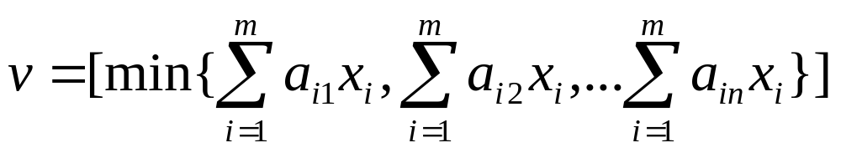
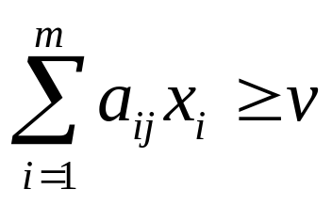
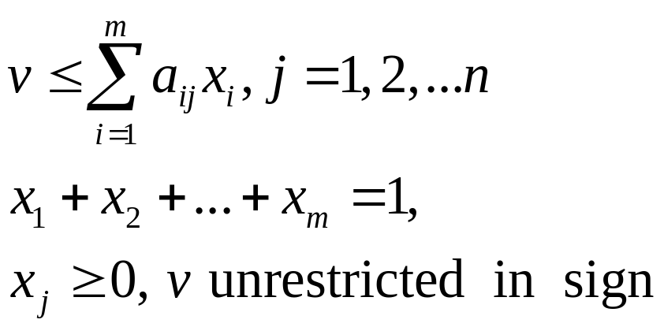
Solution by LP method
Let
This implies
for all j = 1,2,…n
Thus A’^{s} problem becomes
Maximize: z = v
Subject to

Slide 35
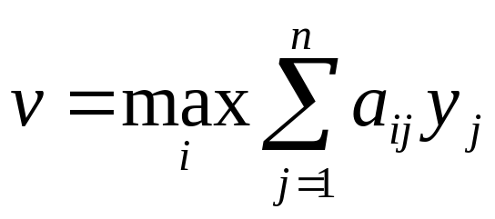
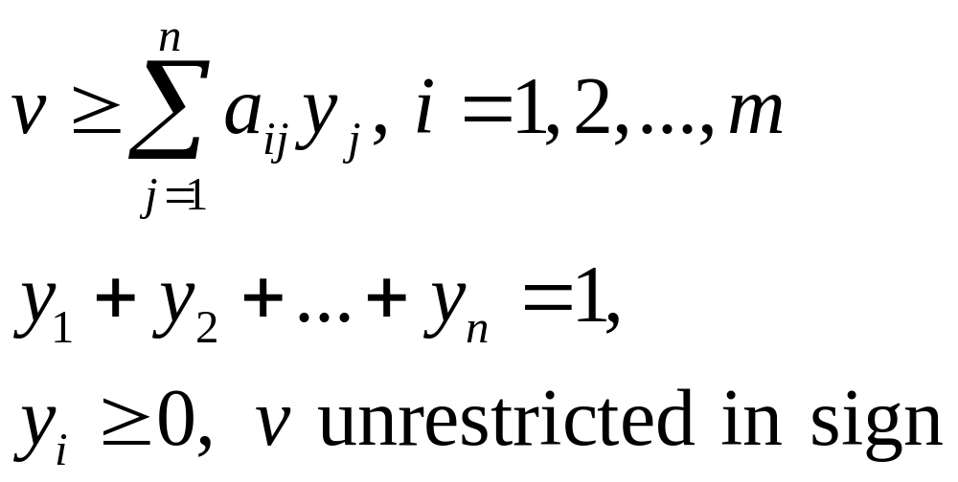
Putting
B’^{s} problem becomes
Minimize : w = v
Subject to

Slide 36
We easily see that B’^{s} (LP) problem is the dual of A’^{s} (LP) problem. Hence the optimal solution of one problem automatically yields the optimal solution of the other.
Problem Solve the following problem by LPP
B₁ B₂ B₃
A₁
A₂
A₃
2 0 0
0 0 4
0 3 0

Slide 37
Note that max (Row Min) = 0 and min (column Max) = 2.
Thus the game has no saddle point and we have to go in for mixed strategies.

Slide 38
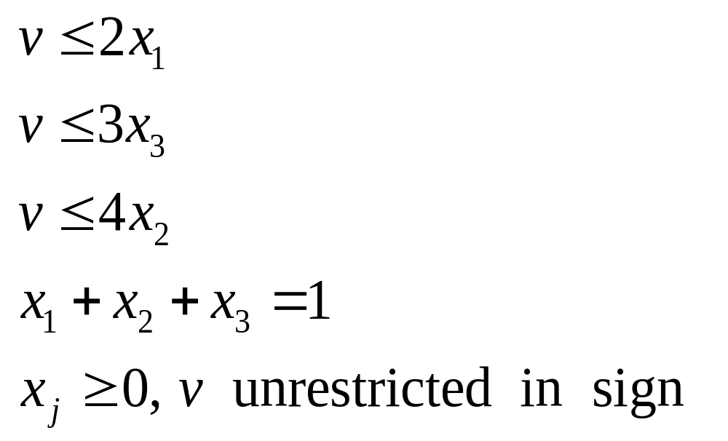
Thus A’^{s} problem is:
Maximize: z = v
Subject to

Slide 39
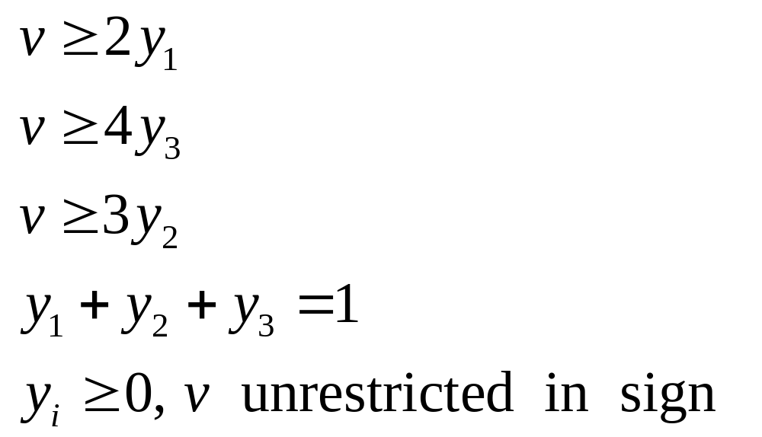
And B’^{s} problem is:
Minimize w = v
Subject to
We now solve A’s problem by two phase method.

Slide 40
This is the optimal table and the optimal solution is:
x₁ = 6/13, x₂ = 3/13, x₃ = 4/13
From the optimal Table we also read the optimal solution of B’s problem as:
y₁ = 6/13, y₂ = 4/13, y₃ = 3/13
And the value of the game is : v = 12/13

Slide 41
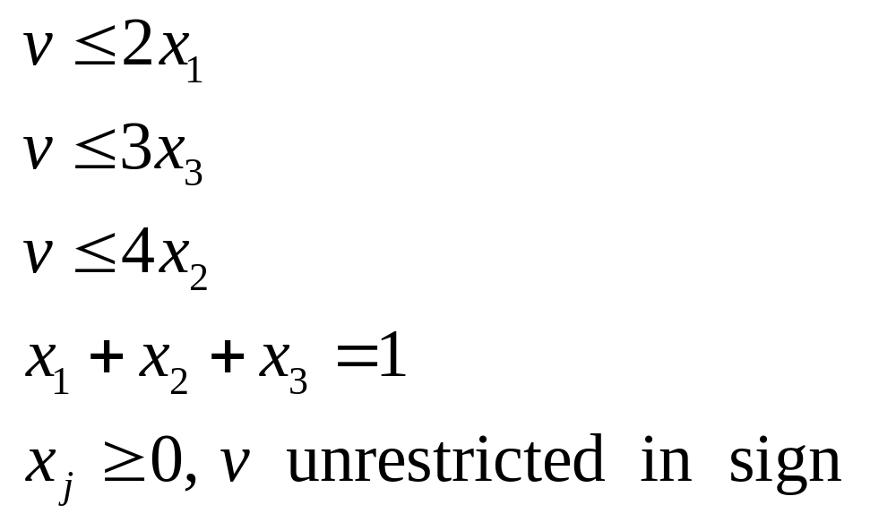
A second look at the LP solution.
We have seen that to find A’^{s} probabilities we have to solve the LPP:
Minimize: 1/z = 1/v , where v is non-zero.
subject to

Slide 42
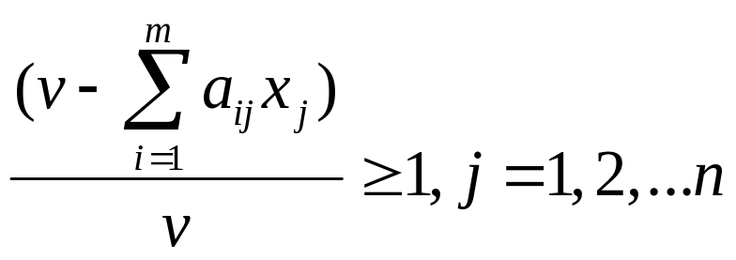
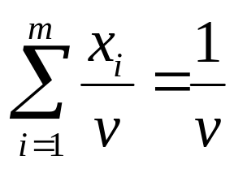
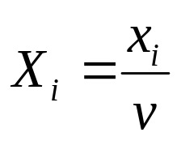
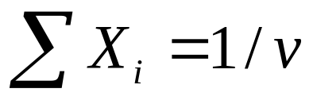
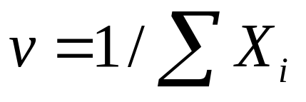
Suppose v > 0 ( for example if each a_{ij} > 0, obviously v > 0)
Dividing all the constraints by v we get
maximize : z = v
subject to
,
, i=1,2….m
Put
Thus
or

Slide 43
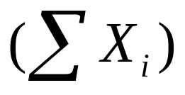
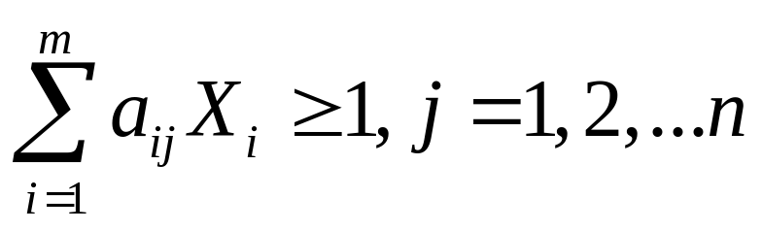
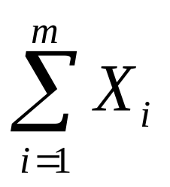
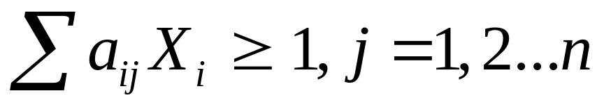
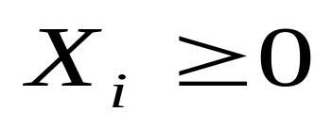
Thus the problem becomes
minimize:
1/z =
Subject to
Or minimize
Subject to

Slide 44
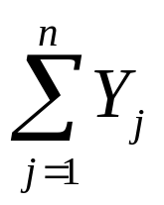
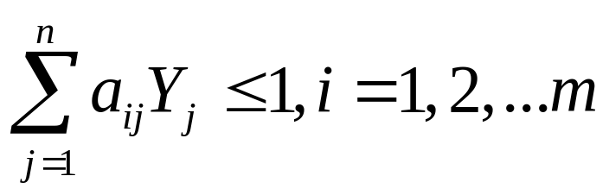
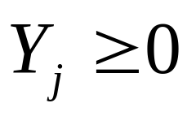
Similarly putting Y_{j}=y_{j}/v, B’^{s} problem is
maximize
Subject to
Now it is easy to solve this LP problem by Primal Simplex method .

Slide 45
Note: if some a_{ij} < 0, we add a constant
a positive K to each a_{ij} so that all new a_{ij}> 0.
And then after solving, the value of the game is the value obtained by subtracting K.

Slide 46
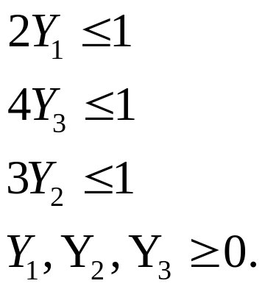
Now we redo the previous problem. Remember we solve B’^{s} problem only.
Maximize: Y₁+ Y₂+Y₃
Subject to
Thus Y₁ = 1/2, Y₂ = 1/3, Y₃ = 1/4

Slide 47
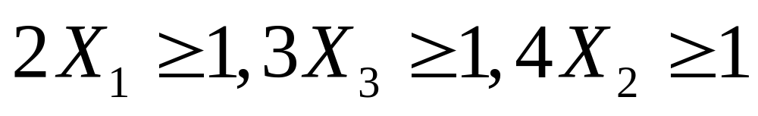
Value of the game = v = 1/(Y₁+Y₂+Y₃) =12/13
y₁= Y₁v = 6/13, y₂ =Y₂v = 4/13, y₃ = Y₃v =3/13 . Similarly A’^{s} problem is
minimize: X₁ + X₂ + X₃
subject to
Optimal solution is X₁=1/2, X₂=1/4, X₃=1/3
Therefore x₁ = X₁v = 6/13, x₂ = X₂v = 3/13, x₃ = X₃ v = 4/13

Slide 48
Solve the problem
B₁ B₂ B₃
A₁
A₂
A₃
2 -3 4
-3 4 -5
4 -5 6
Add 6 to each entry. We get
B₁ B₂ B₃
A₁
A₂
A₃
8 3 10
3 10 1
10 1 12

Slide 49
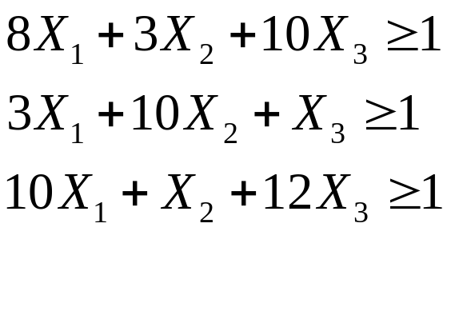

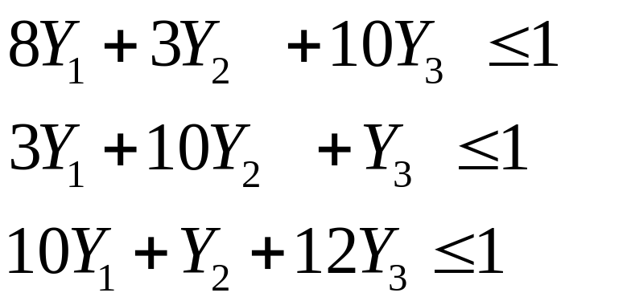

A’^{s} problem minimize: z = X₁+X₂+X₃
Subject to
B’^{s} problem maximize : z = Y₁+Y₂+Y₃
Subject to
We solve B’s problem by Simplex method.

Slide 50
v = 1/(Y₁ + Y₂ + Y₃) = 6
y₁= 1/4, y₂= 1/2, y₃= 1/4
Value of the game = 6-K=0
x₁= 1/4, x₂ = 1/2, x₃ =1/4

